Slide 1
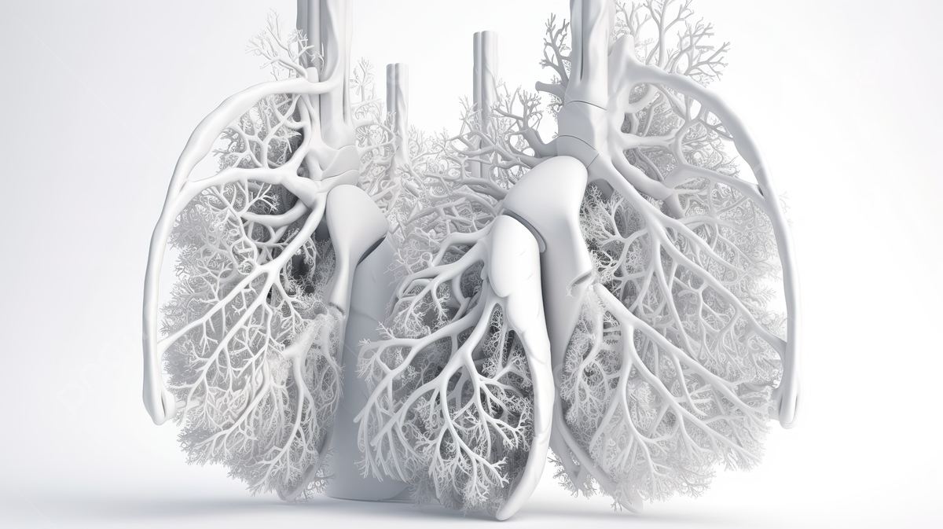

American International University-Bangladesh
Lungs and Colon Cancer Detection Using Deep Learning
Supervised By Dr. S. M. Hasan Mahmud
Assistant Professor (Supervisor)
Department of Computer Science
American International University-Bangladesh

Slide 2

Team Members
Mehedi Hasan Mahin(17-34902-2)
Umma Atiya Maysha(18-36150-1)
Minuar Hossin Tanzir(20-42246-1)
Abdullah, C. M.(18-38631-2)

Slide 3
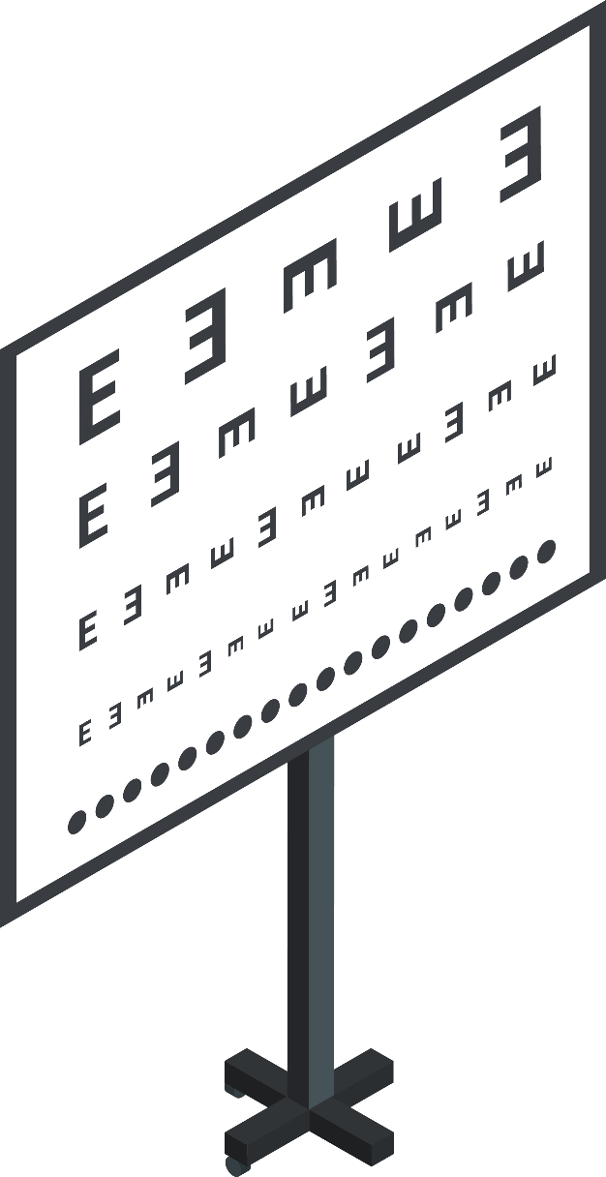
CONTENTS
1
Introduction
2
Literature Review
3
DataSets
4
Methods
5
Flowchats
6
Algorithm
7
Accuracy & Result
8
Discussion
9
Conclusion
10
Future Work

Slide 4
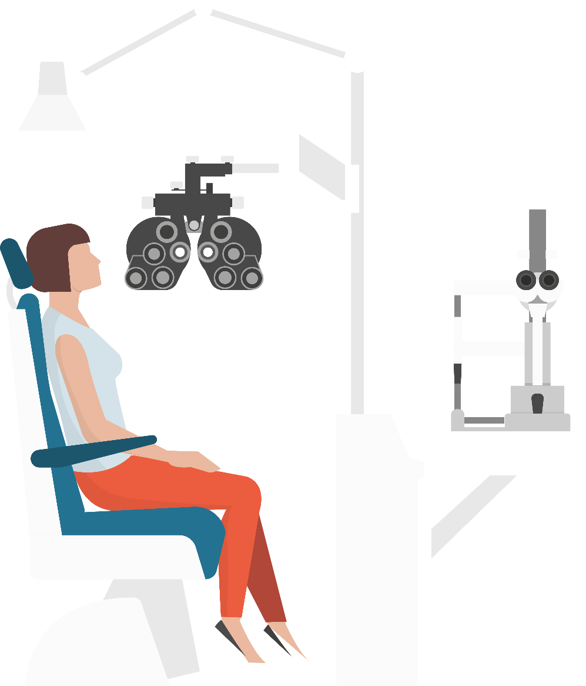
Introduction
Significance of Lung and Colon Cancers
Impact of Timely Recognition
Challenges in Histopathology Diagnosis
Global Burden of Cancer
Role of Deep Learning in Cancer Detection

Slide 5

Literature Review
Multi-input dual-stream capsule network for improved lung and colon cancer classification
[1]Ali, M. and Ali, R., 2021. Multi-input dual-stream capsule network for improved lung and colon cancer classification. Diagnostics, 11(8), p.1485.
Machine learning-based lung and colon cancer detection using deep feature extraction and ensemble learning.
[2]Talukder, M.A., Islam, M.M., Uddin, M.A., Akhter, A., Hasan, K.F. and Moni, M.A., 2022. Machine learning-based lung and colon cancer detection using deep feature extraction and ensemble learning. Expert Systems with Applications, 205, p.117695.
A recent survey on colon cancer detection techniques
[3] Rathore, S., Hussain, M., Ali, A. and Khan, A., 2013. A recent survey on colon cancer detection techniques. IEEE/ACM Transactions on computational biology and bioinformatics, 10(3), pp.545-563.

Slide 6
Literature Review
Biomedical image analysis for colon and lung cancer detection using tuna swarm algorithm with deep learning model.
[4] Obayya, M., Arasi, M.A., Alruwais, N., Alsini, R., Mohamed, A. and Yaseen, I., 2023. Biomedical image analysis for colon and lung cancer detection using tuna swarm algorithm with deep learning model. IEEE Access.
A machine learning approach to diagnosing lung and colon cancer using a deep learning-based classification framework
[5]Masud, M., Sikder, N., Nahid, A.A., Bairagi, A.K. and AlZain, M.A., 2021. A machine learning approach to diagnosing lung and colon cancer using a deep learning-based classification framework. Sensors, 21(3), p.748.
A framework for lung and colon cancer diagnosis via lightweight deep learning models and transformation methods.
[6] Attallah, O., Aslan, M.F. and Sabanci, K., 2022. A framework for lung and colon cancer diagnosis via lightweight deep learning models and transformation methods. Diagnostics, 12(12), p.2926.

Slide 7
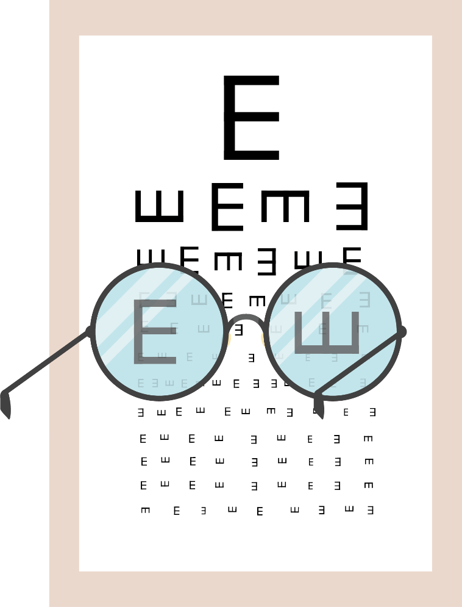
DataSets
Data Collection
Utilizing Kaggle's LC25000 datasets, our model preprocesses lung and colon cancer images with standardized resizing and color conversion.
Data augmentation and feature scaling enhance robustness.
Employing VGG16, ResNet50, and MobileNetV2 for deep feature extraction, followed by Random Forest and SVM, ensures comprehensive cancer detection.
Ensemble learning consolidates predictions, contributing to a holistic approach for accurate lung and colon cancer identification.
The proposed model's workflow and efficacy are depicted in a detailed block diagram.

Slide 8
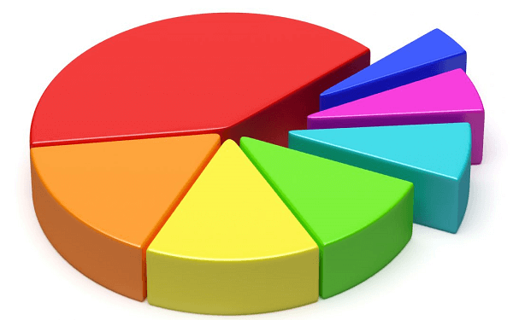
DataSets
Data Analysis
80%
Training
We have taken 20000 rows for training our datasets
20%
Testing
We have taken 5000 rows for testing and validation

Slide 9

Methods
Image Processing
Feature Extraction
Classifier
Evalution

Slide 10
Flowcharts of Progression
Lungs and Colon Cancer
Datasets
Cleaning
Preproccing
Normalization
Feature extrantion
Feeding ML
Detection

Slide 11
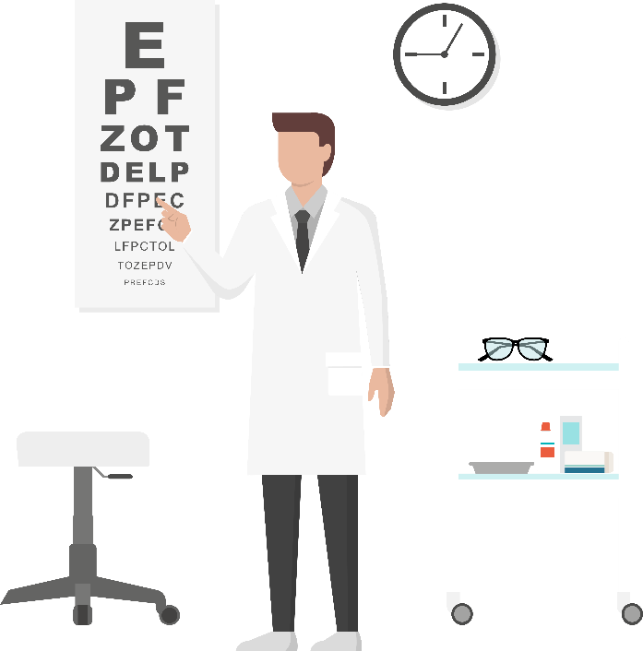
Integrated Methodology
Image Preprocessing
Feature Extraction
Image preprocessing involves resizing for consistency, normalization to scale pixel values, grayscale conversion for simplicity, crop/pad for standardization, rotation/flipping for data augmentation, histogram equalization for contrast improvement, Gaussian blurring for noise reduction, image enhancement for visual quality, removing unwanted artifacts, and data augmentation for robustness in machine learning models..
Feature extraction is a crucial step in data analysis and machine learning, involving the transformation of raw data into a simplified, representative set of features. This process enhances model performance by focusing on essential information, reducing dimensionality, and capturing key patterns for more effective analysis and predictions.
Classifier
Evaluation
Random Forest leverages ensemble learning, constructing multiple decision trees for robust predictions. K-Nearest Neighbors (KNN) classifies based on nearby data points, making it effective for diverse classification tasks with a focus on local patterns.
Evaluation metrics assess the performance of machine learning models. Common metrics include accuracy, precision, recall, F1 score, and confusion matrix. They provide insights into a model's effectiveness, helping to fine-tune and optimize its performance based on specific objectives and requirements..

Slide 12
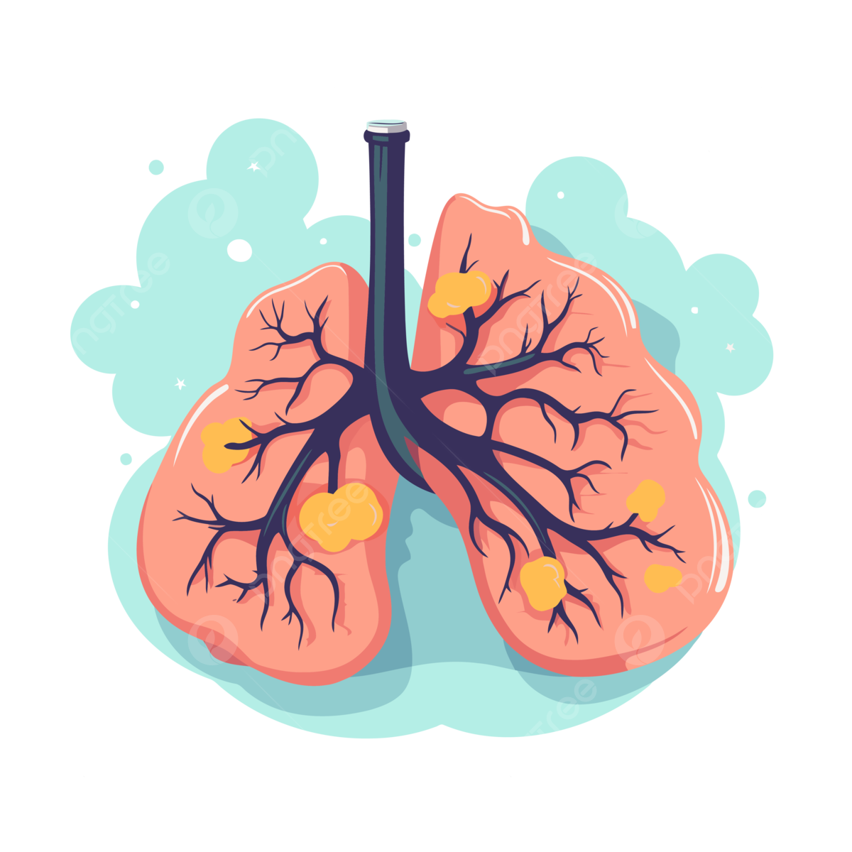
Image Preprocessing
Cancer Image
Image Resize: 128*128
Image conversion: BGR to RGB
Image conversion: Image to NumPY array
Image Scaling: Image 255
Image Labeling

Slide 13
Algorithm
Scikit Learn
Matplotlib
OpenCV
TensorFlow
Seaborn
Pandas
NumPy

Slide 14

Accuracy
Classification & Performance Metrics

Slide 15
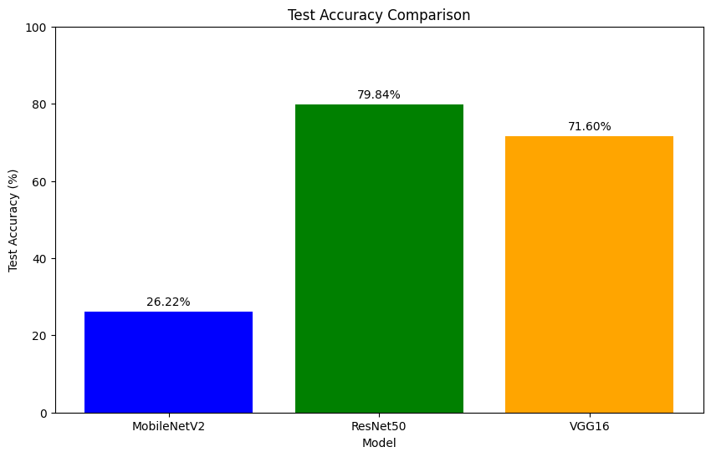
Comperision Result
Scratch CNN exhibited the highest accuracy (87%) with Random Forest classification after the application of the Gaussian filter.
ResNet50 showed promising results with a test accuracy of 79.84% and strong performance across all classes.
VGG16 demonstrated moderate performance (71.60%) but struggled with certain classes like "Lung Adenocarcinoma."
MobileNetV2 had suboptimal performance with a test accuracy of 26.22% and needs further refinement.

Slide 16
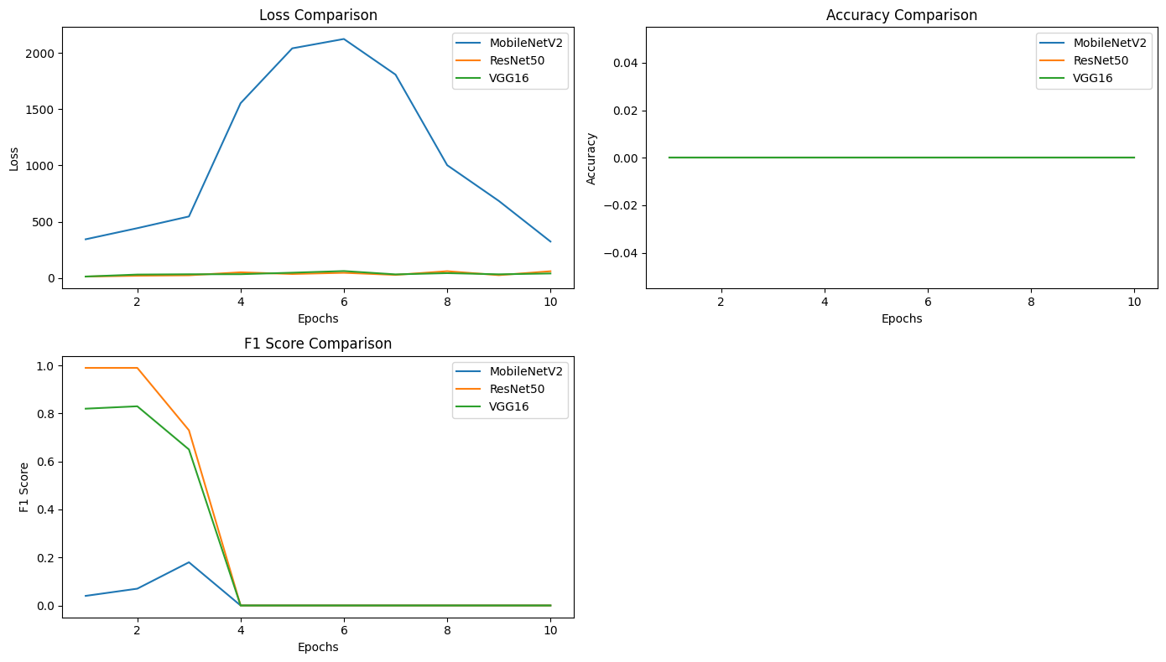
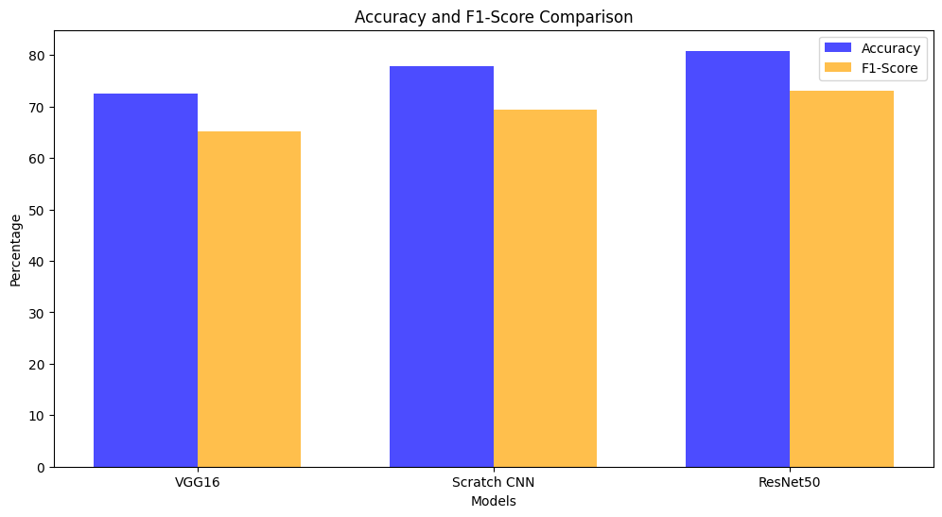
Analysis of CNN Models for Gaussian

Slide 17
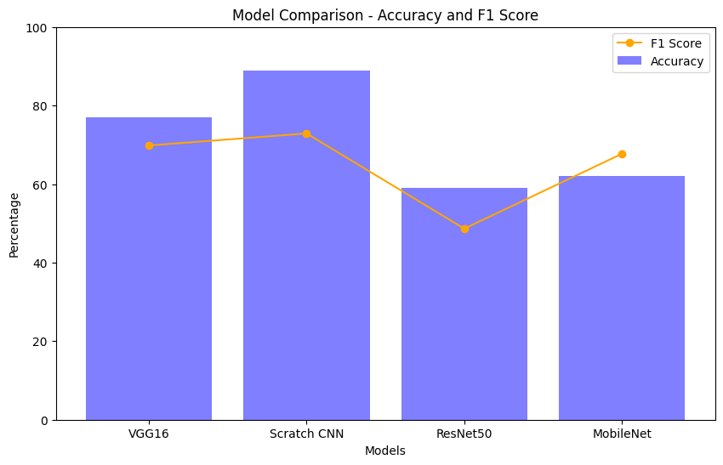
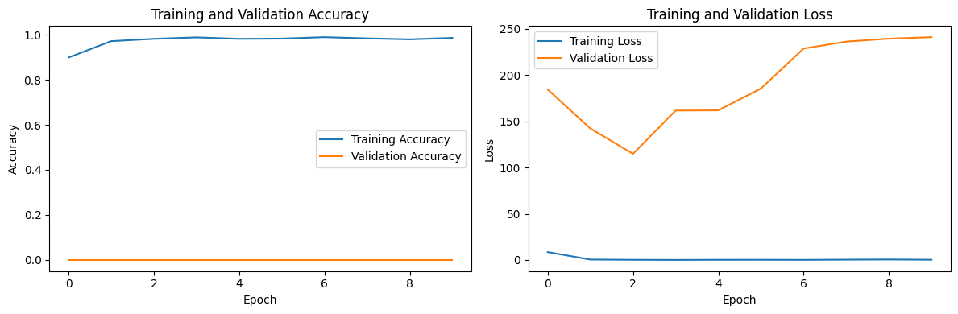
Analysis of CNN Models for Unsharp Mask Filter

Slide 18
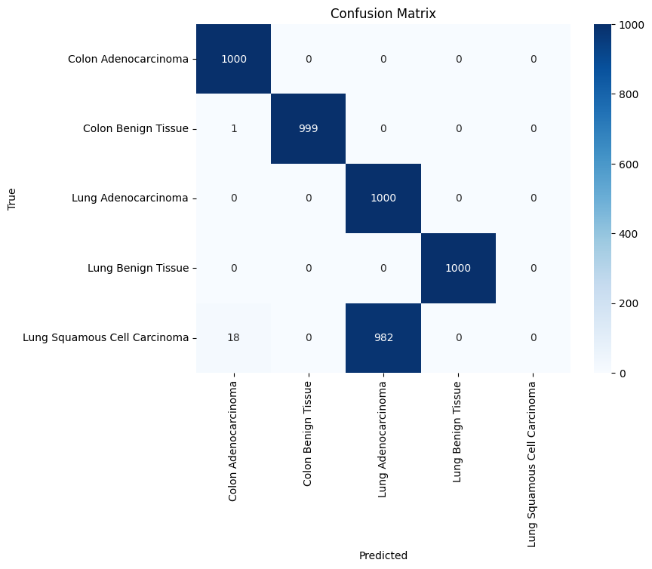
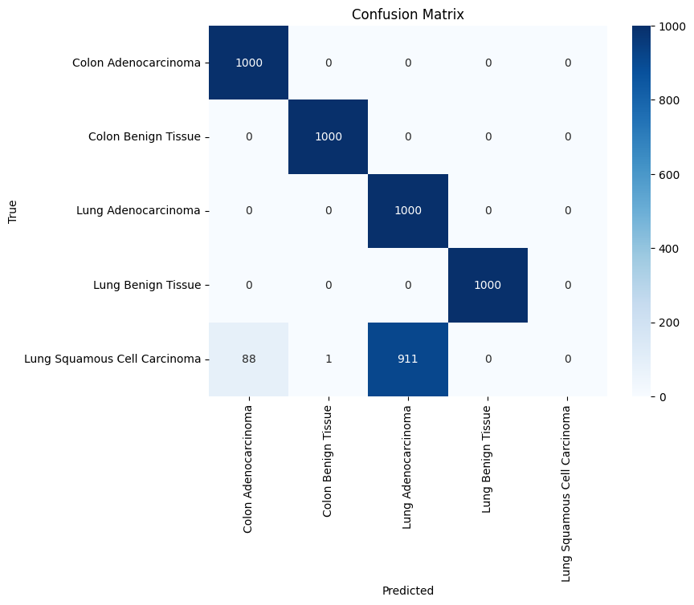
Confusion Matrics

Slide 19
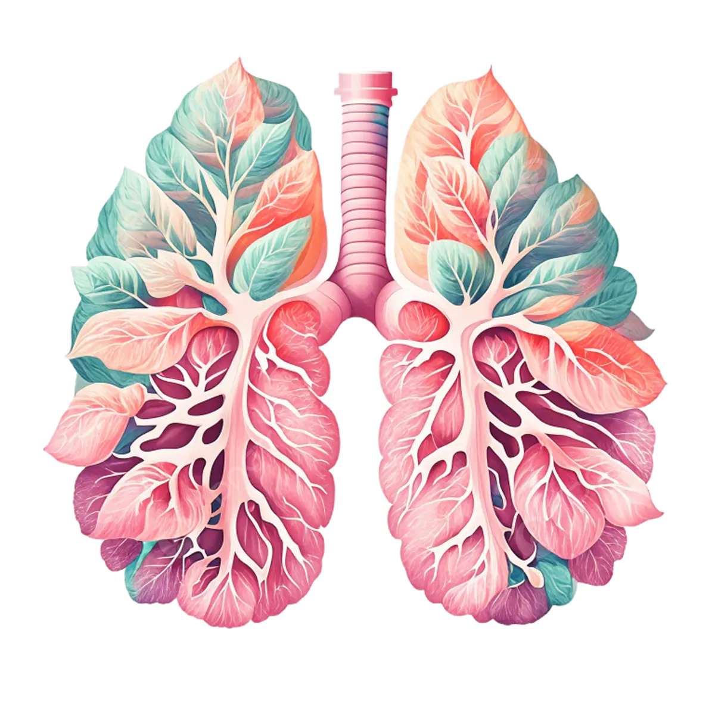
Discussion
Multidisciplinary Integration
Significance of Biomarkers
Innovative Hybrid Model
Hybrid Model Success

Slide 20
Conclusion
Precision Refinement
Multi-Modal Integration
Clinical Support for Healthcare Professionals
Optimal Filters in MRI Images

Slide 21

Comprehensive Methodology
Ethical Considerations and Transparency
The research employs a holistic approach, integrating image pre-processing, deep feature extraction, high-performance filtering, ensemble learning, and a proposed model for the detection and classification of lung and colon cancer. This structured methodology encompasses data handling, cleaning, and clinical validation.
The study prioritizes ethical standards, emphasizing patient data privacy, responsible image use, and compliance with regulations. Rigorous data handling protocols ensure transparency in medical research, aligning with ethical considerations throughout the entire process.

Slide 22
1
Applying deep learning models for improve accuracies.
Future Work
2
Collecting most recent dataset from a wide range of sources.
3
To increase the detection of web threats, deep learning techniques can be used with more conventional methods like static analysis, dynamic analysis, and hybrid analysis

Slide 23

Integration of Advanced Imaging Techniques
Machine Learning Optimization
Multi-modal Data Fusion
Real-time Monitoring Solutions
Personalized Medicine Approaches
Collaboration with Healthcare Professionals

Slide 24

Thanks for attention
Any Question???

